Slide 1



FINAL PROJECT TABLEAU DATASET: FAA WILDLIFE STRIKES, 2015
AMUSA IDRIS ADEBOLA

Slide 2

AGENDA
PROJECT/GOALS
PROCESS
RESULTS
CHALLENGES
FUTURE GOALS

Slide 3
PROJECT/GOALS

Slide 4
PROJECT GOALS
This project involves the analysis and visualization of wildlife strikes reported by airlines, airports, pilots, and other sources in the United States. The dataset covers the years 2000-2015 and is sourced from the FAA Wildlife Strike Database.

Slide 5
PROCESS

Slide 6
PROCESS
1. Connect your data.
2. Detect different data types in your data.
3. Build at least 5 different visualizations to learn more about the dataset.
4. There are three main different categorical features in the table. Try to learn more about these categories and find appropriate numerical features to study different trends.
Effect
When
Wildlife
5. In your final project you should show visualizations with:
Maps
Date and time
Analytical visuals (Forecasting - Clustering)
Show Me tables

Slide 7
PROCESS
6. Try to find an interesting pattern, trend, outlier, etc. from the data used in the above steps.
7. From step 5, try to detect meaningful keypoints. This is the starting point to think about your dashboard.
8. Come up with different questions which you will be answering and presenting at the end of this project.
9. Create the dashboard to answer your questions that you came up with in step 8 and try to revise your questions along the way.
10. Get ready to present your dashboard.

Slide 8
RESULTS

Slide 9
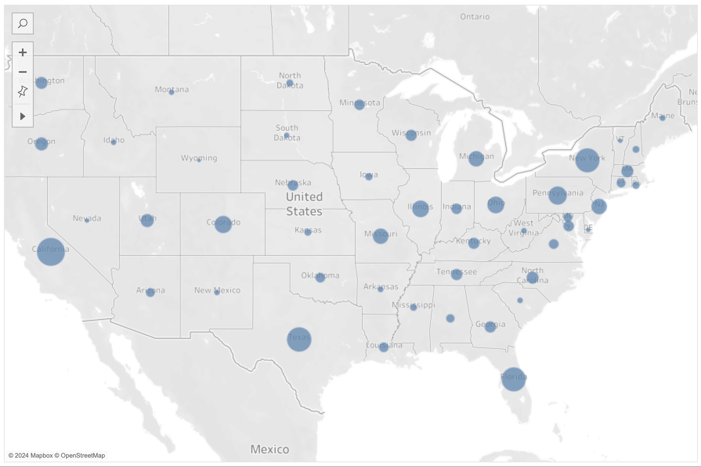
RESULTS
Question: Where are the hotspots for wildlife strikes in the United States?
Answer: The hotspots for wildlife strikes in the United States are California (3,026), Texas (2,306), Florida (2,239) and New York (2,140). Conversely, Wyoming has the least amount of wildlife strikes (50).

Slide 10
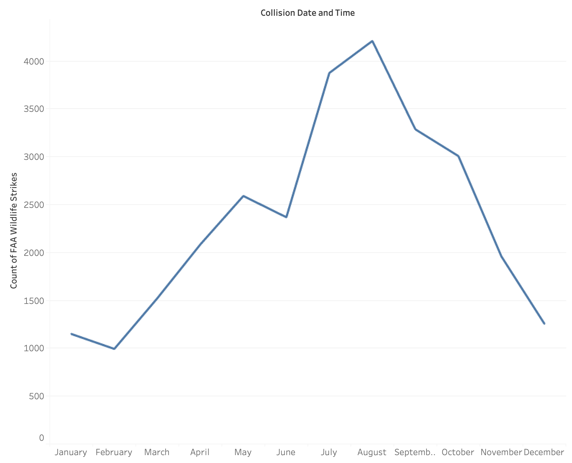
RESULTS
Question: Is there a particular time of the year when wildlife strikes are more prevalent?
Answer: Wildlife strikes are more prevalent in August (4,209), July (3,875) and September (3,286).

Slide 11
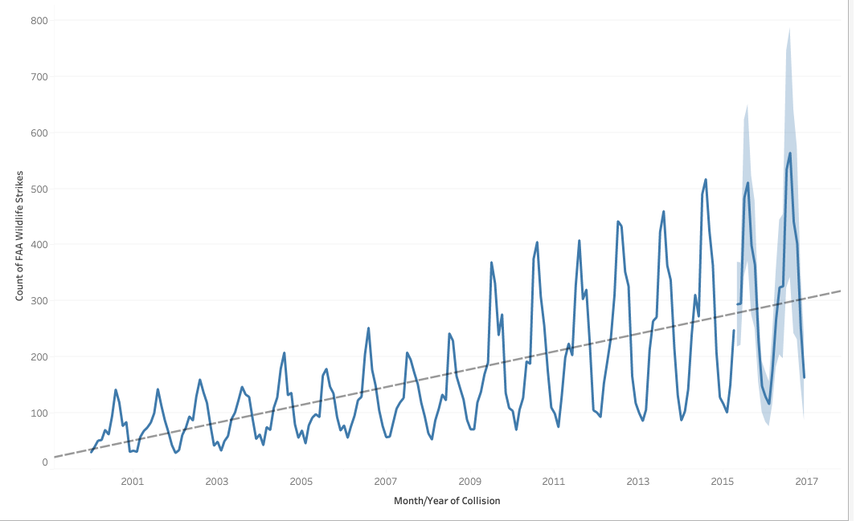
RESULTS
Question: Can we predict the future trend of wildlife strikes?
Answer: Yes, the future trend for the next 2 years shows there will be an increase in wildlife strikes.

Slide 12
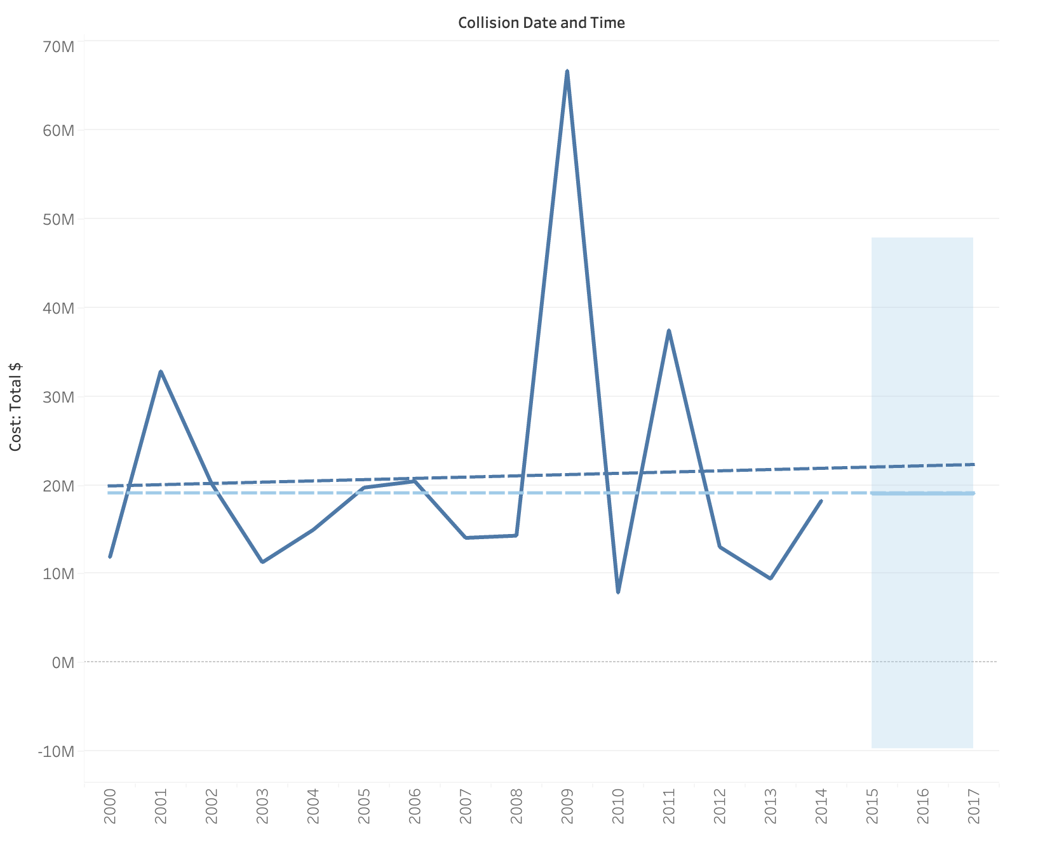
RESULTS
Question: What is the yearly cost of damages from wildlife strikes? Can you also forecast the cost of damages for the next 2 years?
Answer: The wildlife species most frequently involved in strikes are Mourning dove (2,002), Gulls (1,792), Barn swallow (1,629), European starling (1,462), and Horned lark (1,223).

Slide 13
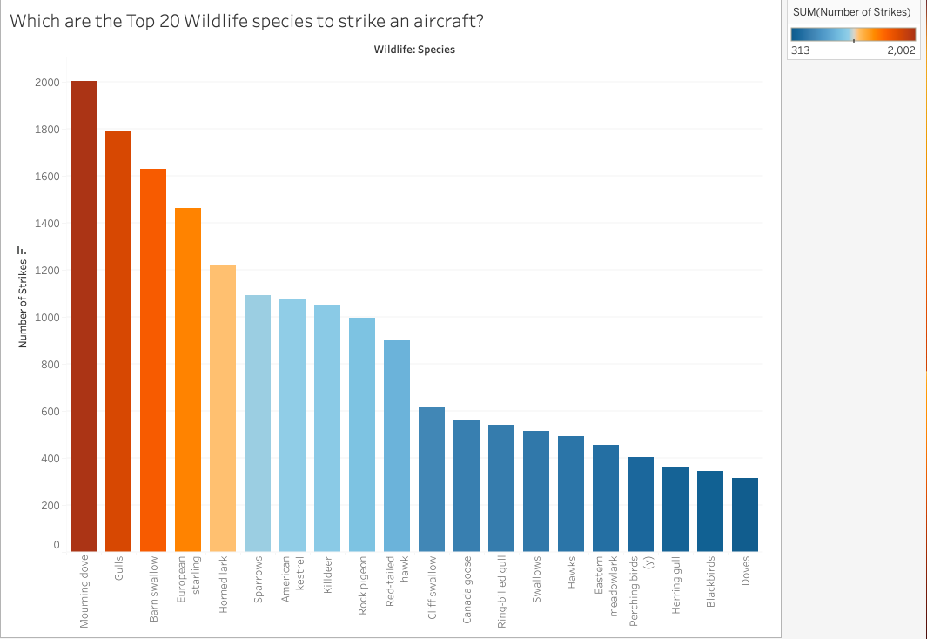
RESULTS
Question: Which wildlife species are most frequently involved in strikes?
Answer: The wildlife species most frequently involved in strikes are Mourning dove (2,002), Gulls (1,792), Barn swallow (1,629), European starling (1,462), and Horned lark (1,223).

Slide 14
Learnings from the Data
The wildlife species most frequently involved in strikes are Mourning dove (2,002), Gulls (1,792), Barn swallow (1,629), European starling (1,462), and Horned lark (1,223).
The hotspots for wildlife strikes in the United States are California (3,026), Texas (2,306), Florida (2,239) and New York (2,140). Conversely, Wyoming has the least amount of wildlife strikes (50).
Wildlife strikes are more prevalent in August (4,209), July (3,875) and September (3,286).
Wildlife strikes are increasing yearly. We predict an increase in wildlife strike over the next 2 years.
From the dataset, the year with the highest cost of damages from wildlife strikes is 2009 ($66,649,202). Conversely, the year with the lowest cost of damages from wildlife strikes is 2012 ($7,897,771).

Slide 15
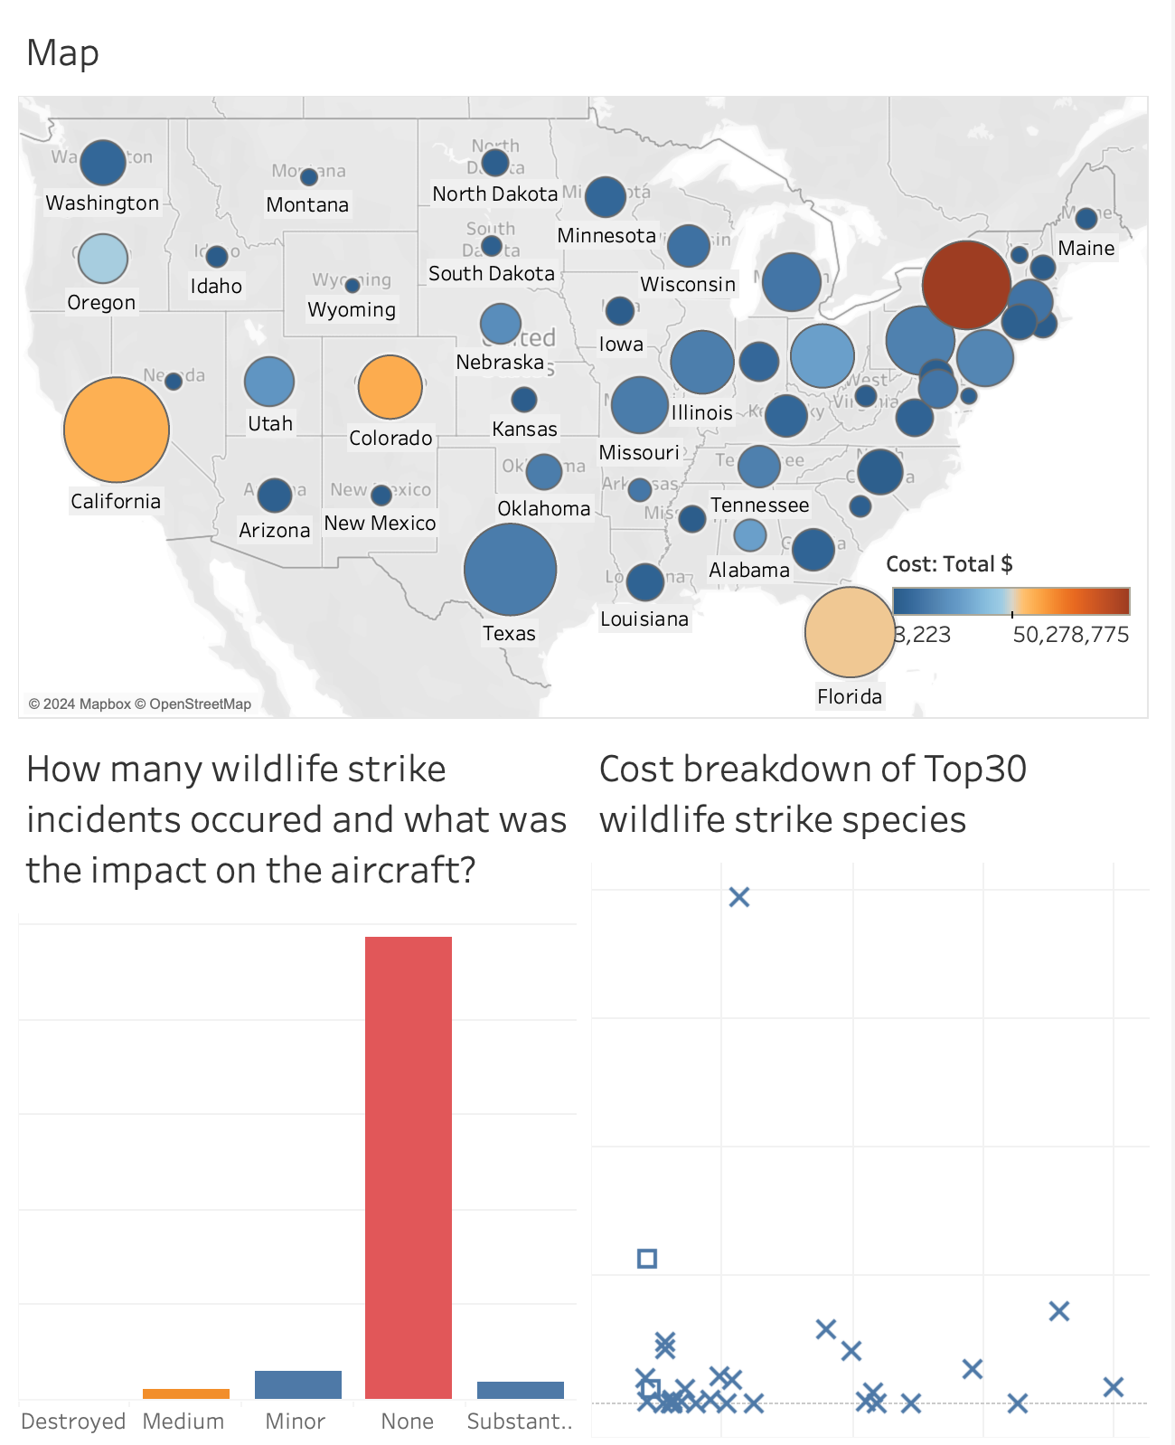
Dashboard

Slide 16
CHALLENGES

Slide 17
CHALLENGES
Data Quality and Completeness: Dealing with missing or inconsistent data, requiring strategies like imputation and validation.
Spatial and Temporal Variability: Analyzing wildlife strikes across locations and time periods with varying reporting standards and environmental factors.
Wildlife Categorization: Accurately categorizing diverse wildlife species in the dataset, suggesting the need for grouping and collaboration with experts.
Forecasting Reliability: Predicting future trends in wildlife strikes with uncertainties due to complex environmental and aviation factors.
Dashboard Design Complexity: Designing an effective and user-friendly dashboard to meet diverse stakeholder needs and preferences.

Slide 18
FUTURE GOALS

Slide 19
FUTURE GOALS: If I had more time
Explore additional features or external datasets for more comprehensive analysis.
Refine visualizations and dashboard layout for better user experience.

Slide 20
References
https://github.com/idrisadebolaamusa2/lhl_tableau_project/blob/main/assignment.md
https://www.tableau.com/trial/tableau-software

